Slide 1
Overview
We are going to consume an API from OpenData
https://opendata.vancouver.ca/api/records/1.0/search/?dataset=dog-off-leash-parks&q=&facet=geo_local_area
Dog off leash parks in Vancouver
Our goal is too fetch this data asynchronously and display it in a RecyclerView, similar to recent lecture
The biggest difference here is our code is going to follow the MVP (model-view-presenter) design architecture
Will be discussed throughout instruction

Slide 2
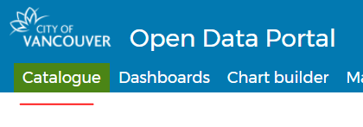
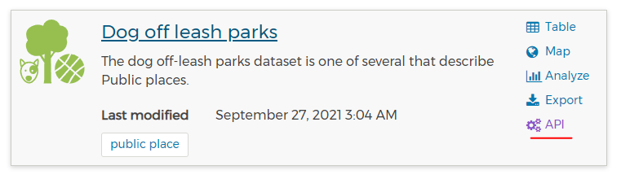
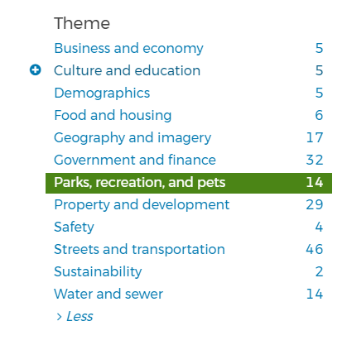
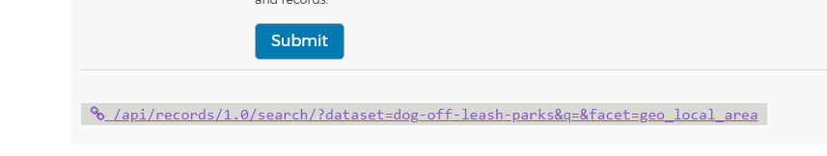
https://opendata.vancouver.ca/pages/home/

Slide 3
Creating our POJO
Since the JSON object is more complex then the cartoon JSON from last lecture we are going to use an online tool to generate our POJO (plain old java object) class
https://json2csharp.com/json-to-pojo
Create a new java class (OffLeashParks.java) and copy/paste the generated code
It should look like something like the image on the next slide

Slide 4
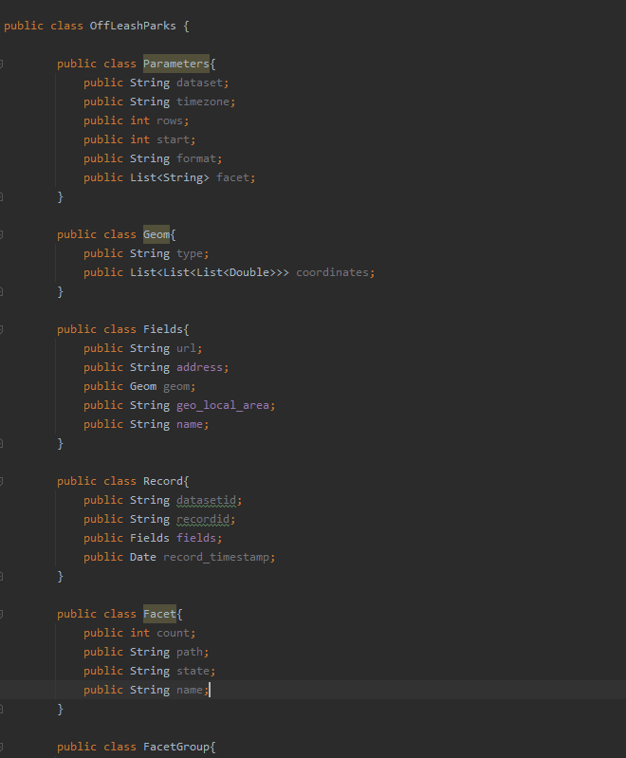

Slide 5
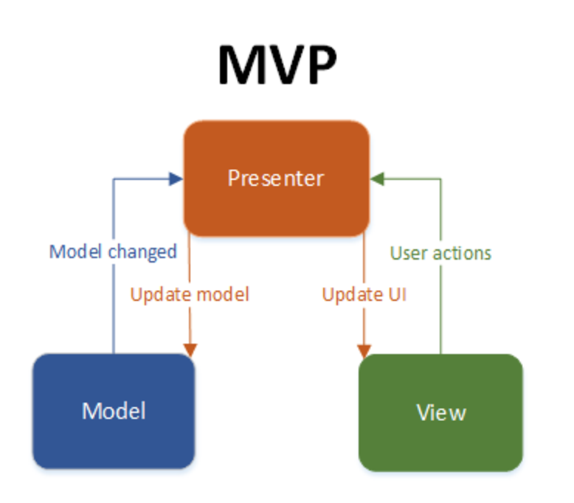
Model View Presenter
MPV architecture is a common way we can set up our code so it is modular and scalable
model-view-presenter

Slide 6
Model View Presenter (cont.)
In Android you can think of the MVP modules like this
Model
Represents and manages the data
View
Activities/Fragments
Views/layouts
Presenter
Mediator for the Model and View
No knowledge of View it is trying to update
Decides what happens when you interact with the View

Slide 7
Model View Presenter (cont.)
Note that MVP is different then MVC (model-view-controller)
MVC vs MVP main differences
Your modules are more tightly coupled with MVC
Presenter/Controller has no relation to the View in MVP
View's are updated through an interface in MVP
To find some more info
Check out Resources->Web Resources/Links on LearningHub

Slide 8
Model View Presenter (cont.)
Create a MainPresenter.java class and a MainModel.java
To keep things simple lets think of the MVP as
Model: MainModel.java
View: MainActivity
Presenter: MainPresenter.java

Slide 9
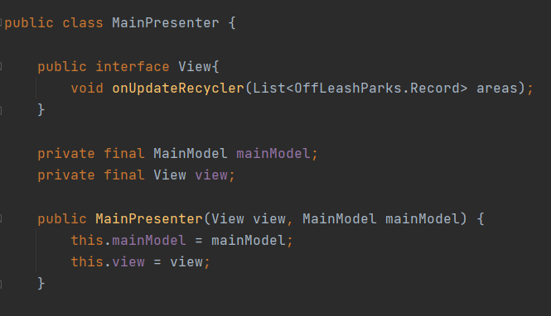
MainPresenter
Inside you MainPresenter.java, create an interface called View with one function
Pass a View and MainModel through the constructor as well

Slide 10
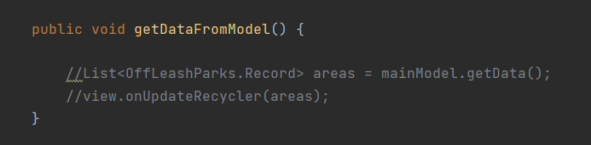
MainPresenter (cont.)
Create a function inside MainPresenter like so
You can see this function will get the data from the model and then onUpdateRecycler will be called here

Slide 11
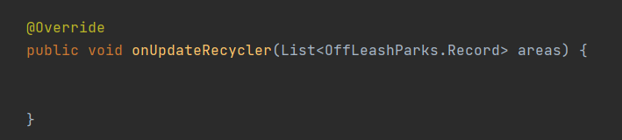
MainActivity
In your MainActivity.java, implement MainPresenter.View and override onDataSuccess

Slide 12
MainActivity (cont.)
As soon as our app runs we want to display a RecyclerView with the data from our API
Lets fill out our onCreate in MainActivity.java
Here we should create our MainPresenter and MainModel objects
Get a reference to our RecyclerView and set the LayoutManager for it
Doesn't need adapter yet, because we don't have data for it
Our MainPresenter object should call the getDataFromModel method
Hopefully you can see now that the Presenter (MainPresenter) has no knowledge of the View (MainActivity)
Take some time to absorb this, but it's all in the View interface

Slide 13
MainModel
The MainModel will be fetching our data from the API and parsing it
The Model represents and manages our data
Persistence and business logic
Example Responsibilities
URL/DB/API management, get/post data, parsing
Note that all these operations can be done in separate classes, but should only interact with the Model, not with the Presenter or View

Slide 14
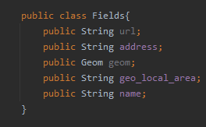
Parsing our JSON
Explore the generated POJO and to see how you can retrieve the required data
Hint: The whole JSON can be parsed into the Root class of the generated POJO
This is assuming you used the online tool I provided, other tools may create different structured POJO's
We only want to display
Name of park
Local geo area
Address

